Slide 1

NHS Code4Health
Dental App challenge
www.handi-hopd.org
Dr Ian McNicoll
HANDIHealth
openEHR Foundation
freshEHR Clinical Informatics
NHS open source event, Newcastle Nov 2014

Slide 2
Dental App challenge
Northumbria Community Dental Services (CDS) currently use paper based clinical records.
Sharing dental information with school nurses about a vulnerable child requires a letter to be generated by the dentist, saved as PDF and sent via email.
Last month, 9.5 days of dentist's time was spent writing these letters. CDS also want to incorporate aspects of the Dental Health Risk score app (RAG) built at a recent NHS Hackday.

Slide 3
Hackday goals
Populate the Patient Demographics via a FHIR-like Patient API 2.
Create the Dental Assessment data entry form
3. Persist the completed Dental Assessment data entry form to the HANDI-HOPD platform (Ehrscape API)
4. Create a service which transforms the persisted document to a PDF for attachment to an email.
5. Re-persist the openEHR document to other openEHR vendor servers (OceanEHR, Code24).

Slide 4
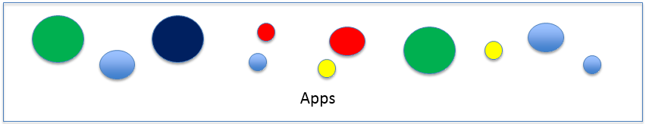

An open standards platform?
OSS
components
ITK Integration component
ESB/Spine
Terminology
Server
Pathways KB
API and messaging content based on open source clinical content definitions
Commit
Retrieve
OSS
Closed
OSS
Closed
Vendor solutions
Vendor A
Vendor B
Vendor C
Vendor D

Slide 5
Resources
Prototype app:
http://c4hdental-handihopd.rhcloud.com
Source:
https://github.com/handihealth/C4H_dental_challenge/tree/master/dental_app
Background material:
https://github.com/handihealth/C4H_dental_challenge/blob/master/README.md
Sample JSON target files:
https://github.com/handihealth/C4H_dental_challenge/tree/master/models/technical/instances

Slide 6
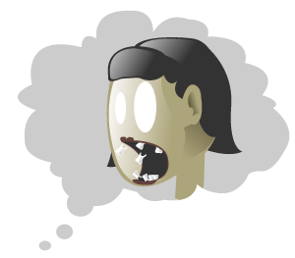
Good luck (this is mad!)
Facilitators
Becky Wassall (Dentist)
Ian McNicoll (Dogsbody)
SMS: 0775 209 7859
http://www.teethfallingoutdream.org/

Slide 7
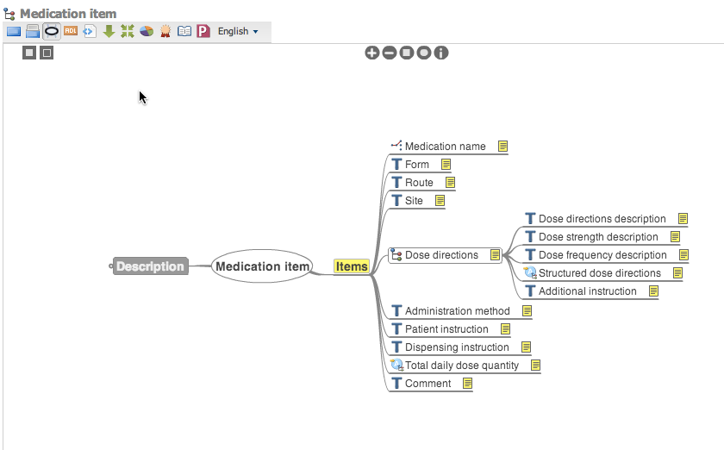
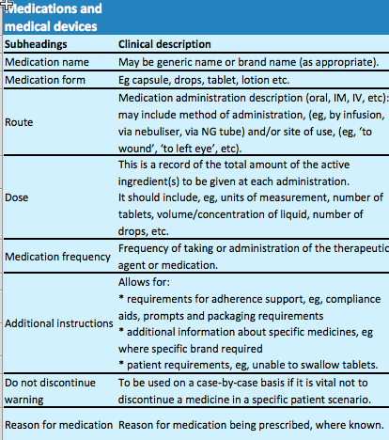
‘Medication archetype’

